Slide 1
dl.sps.northwestern.edu/welcome-teachx-attendees

Slide 2
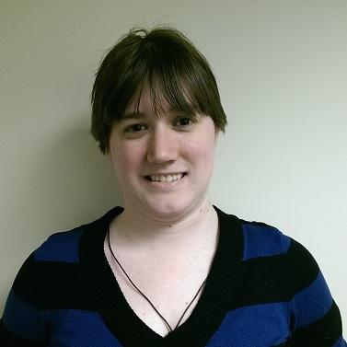
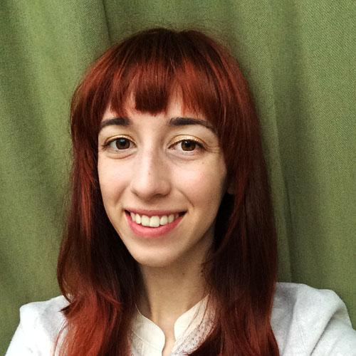
Facilitators
CHRISTINE SCHERER
Content Specialist
christine.scherer@northwestern.edu
KRISTINA WILSON
Learning Designer
krissy@northwestern.edu

Slide 3
What is web accessibility?
Why should you care?

Slide 4
How many students does web accessibility help?
More than you think!
~70%
17%+
Online students with disabilities do not request accommodations
Students requesting accommodations at Northwestern

Slide 5
Let’s check out a page with low accessibility.

Slide 6
Be descriptive!
Describe
VIDEO,
IMAGES,
and DATA
in text.

Slide 7
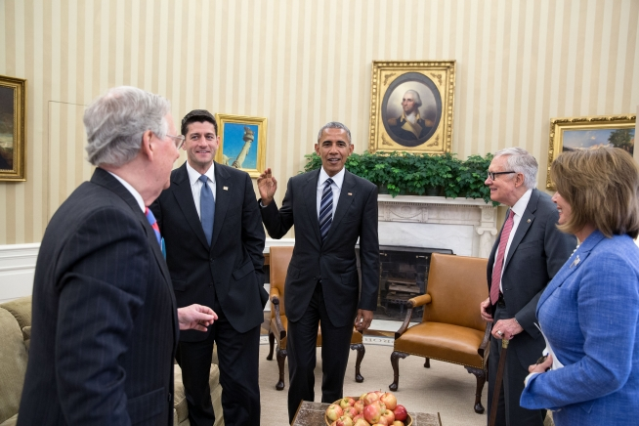
Images need alt-text.
Context is key to creating good alt-text descriptions.
Be descriptive!
Alt-text: none
Alt-text: President Obama meets with congressional leadership in the Oval Office.

Slide 8
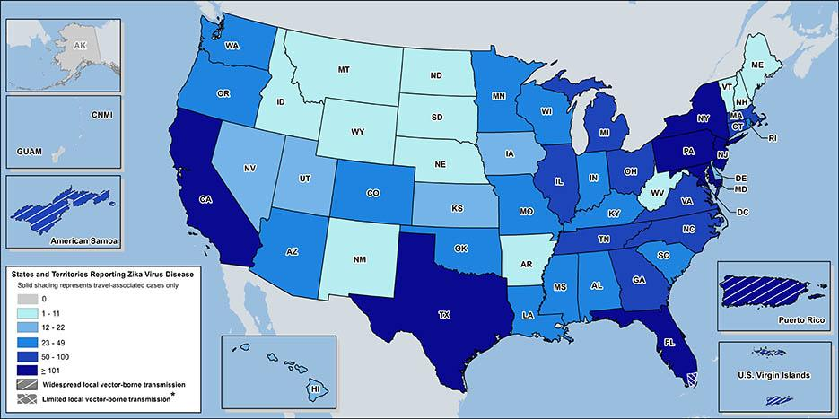
Complex images require detailed alt-text.
Graphs, charts, and maps need in-depth descriptions.
Be descriptive!

Slide 9
Be descriptive!
Audio and video need alt-text, too.
Transcripts and captions support a number of students.
Hearing impaired students
Non-native English speakers
Commuters watching on public transit
Many more!

Slide 10
Be descriptive!
Scripting makes captions a snap.
By writing scripts for videos, you’re more likely to stay on-track when talking. And the script can be used as the basis for captions when the video is done.

Slide 11
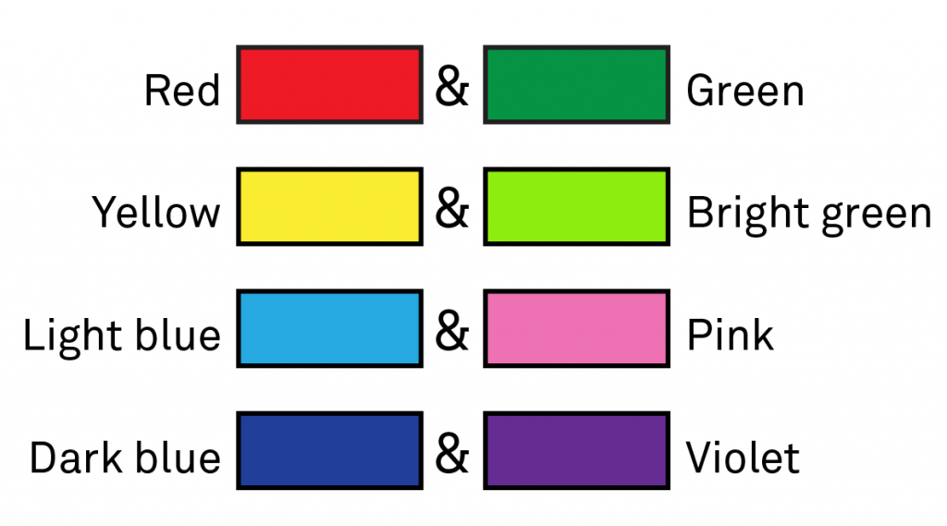
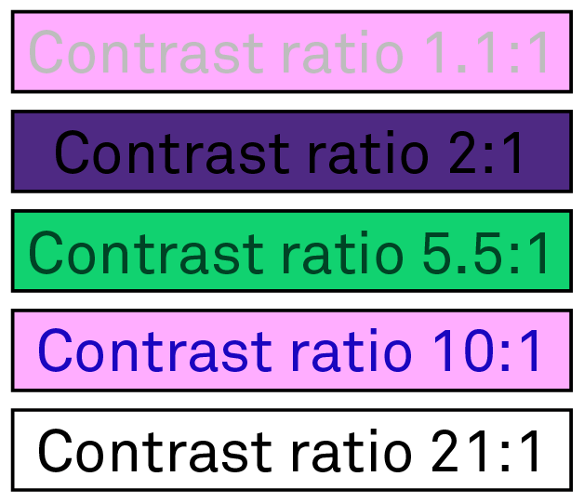
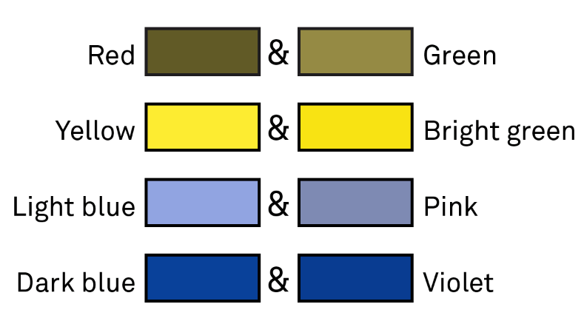
Color and Usability

Slide 12
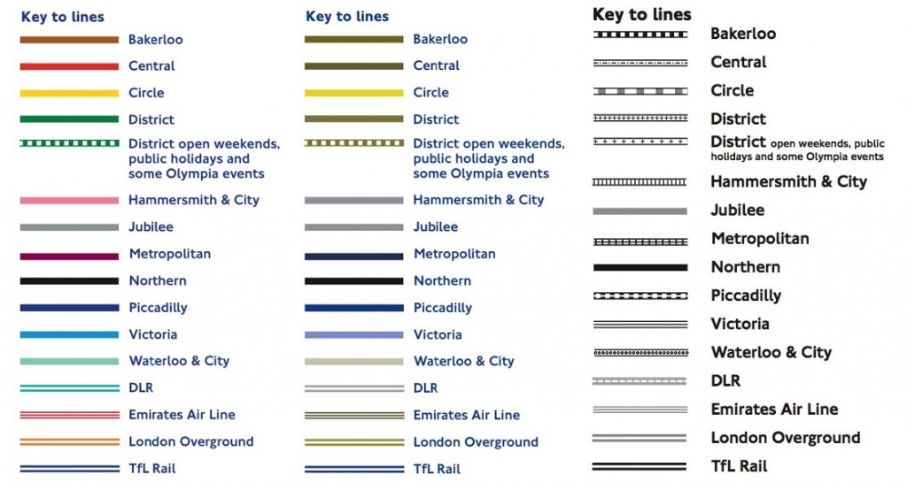
Color and Usability

Slide 13
Formatting
Don’t forget about white space.
Better readability for everyone! Especially students with learning disabilities or attention disorders.
No more “Assignment 1.”
Describe your pages and modules thoroughly, and try using a numbering scheme to keep it concise, i.e. Module 3 Baking Cookies Journal Entry.
Headers are easy!
Headers tag sections so that they can be accessed quickly, and most LMSs have dropdowns you can use instead of coding.

Slide 14
Composing links
Avoid “Click here” terminology.
Where is here? Be specific and descriptive.
30 Accessibility Tips, not Click here to view 30 Accessibility Tips.
Don’t leave URLs out in the open.
Screen readers read the whole string in fits and starts.
30 Accessibility Tips, not http://goo.gl/vmJ50p

Slide 15
Writing and style
Write out dates.
Otherwise, screen readers will read strings of numbers.
Unexpanded acronyms can be cryptic.
How will you know that SPS refers to the School of Professional Studies?

Slide 16
Let’s check out a page with high accessibility.

Slide 17
Policy and advocacy
Get that syllabus statement out there.
Make sure your students are aware of the services they can receive.
Many schools provide a template statement.
Advocate with your words.
Explain why you’re taking these steps or making these changes to raise awareness about the need for web accessibility.

Slide 18
“Deliver an accessible product from Day 1 and the dividends will pay off. If the way you design your course means a student who would otherwise have to self-identify doesn’t, I would say you have leveled the playing field.”
Dr. Alison May, Director of AccessibleNU

Slide 19
Questions?

Slide 20
Thank you for joining us!
Please contact
Christine Scherer (christine.scherer@northwestern.edu)
or Kristina Wilson (krissy@northwestern.edu)
with any additional questions
Download the slides at: dl.sps.northwestern.edu/welcome-teachx-attendees

