Slide 1
Planning to Write an
Accessible Online Course
Notes:
CS: Thank you for coming! Etc.

Slide 2
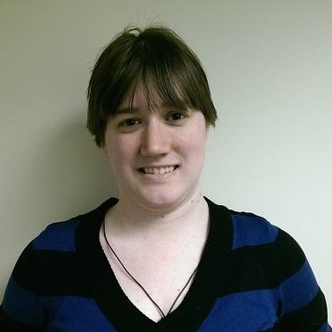
Facilitators
CHRISTINE SCHERER
Content Editor
christine.scherer@northwestern.edu
KRISTINA WILSON
Learning Designer
krissy@northwestern.edu
Notes:
CS: Trains SPS faculty developing and revising courses on SPS accessibility guidelines.
KW: Developed retroactive ADA compliance workflow for student employees at DePaul SNL.

Slide 3
What is web accessibility?
Why should you care?
Notes:
CS: 30-second explanation of web accessibility - Ensure that web content is accessible to all users, including those with visual or auditory impairment, physical or mobility impairment, learning disabilities, and a myriad of other special needs. They may access web content using a variety of tools, including screenreaders, magnification tools, captions, and others. Designing for users plus tools equals total web accessibility.
KW: Adult students have a higher incidence of disability; least likely to seek accommodations. And others may be more likely to take online courses. Be proactive and anticipate their needs.
KW: When you’re writing module content for your online class, it is best practice to contextualize all of the course elements—objectives, readings, activities, assessment. That can mean a good amount of writing from the faculty perspective. You may find yourself doing a lot more writing than you usually would for an on-ground class.
CS: Accessibility takes the least time when you consider it from the beginning. Here are a few simple—and I mean simple—things you can do to improve web accessibility as you are writing the content for your online class. You don’t need to have any technological expertise for this! Don’t need to know any HTML to consider these options.

Slide 4
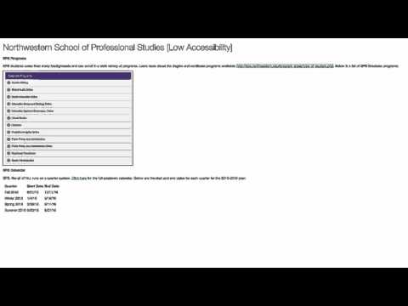
Let’s check out
a page with low accessibility.
Notes:
CS: Looks innocuous, right? It’s just a standard webpage! Actually… screenshot of degree programs, copy-pasted URL and table of dates. However... [Play video]

Slide 5
Composing links
Avoid “Click here” terminology.
Where is here? Be specific and descriptive.
30 Accessibility Tips, not Click here to view 30 Accessibility Tips.
Don’t leave URLs out in the open.
Screenreaders read the whole string in fits and starts.
30 Accessibility Tips, not http://goo.gl/vmJ50p
Notes:
KW: This is what happened there.
Links – Avoid “Click here.”
Links – Avoid those long URL strings.

Slide 6
Text and image
Text is trapped in images.
Screenreaders can’t access it to read aloud.
Alt text is easy in Canvas!
When adding an image using the WYSIWYG editor in Canvas, simply click Embed Image and then fill in the Alt text attribute in the pop-up.
Let us show you how.
Notes:
KW:
Images – No text in images.
Images - Alt text - It’s easy in Canvas! (Demo)
Demo alt text - “Color, monotone, and symbolic versions of the London Tube Map.”
-Brief (under 150 characters max!)
-Conveys the same information

Slide 7
Be descriptive!
Describe
VIDEO,
IMAGES,
and DATA
in text.
Notes:
KW:
Videos – Describe video content in text.
Images – Describe images in text.
Tables – Describe key data points in text rather than presenting lots of data in tables.

Slide 8
Writing and style
Visual landmarks get lost.
If a student has difficulty seeing the course, how can they identify “the video above” or “the bold column”?
Unexpanded acronyms can be cryptic.
Screenreaders read them as words (“edu” becomes “edjoo”).
Notes:
CS:
Text – Consider the use of relative/visual words, i.e. “the link above” or “the bold side of the table.”
Text – Acronyms and abbreviation. Make sure you expand them in text.

Slide 9
Writing and style
Pause and full stop.
If you don’t do it, the screenreader won’t.
Write out dates.
Otherwise, screenreaders will read strings of numbers.
Notes:
CS:
Text – Punctuate! If you don’t pause and full stop, screenreaders won’t either.
Text - Write out dates.

Slide 10
Formatting
Don’t forget about white space.
Better readability for everyone! Especially students with learning disabilities or attention disorders.
No more “Assignment 1.”
Describe your pages and modules thoroughly, and try using a numbering scheme to keep it concise, i.e. 3.4 Baking Cookies Journal Entry.
Headers are easy in Canvas!
Headers tag sections so that they can be accessed quickly.
Let us show you how.
Notes:
KW:
Formatting – Descriptive, specific page titles and module titles.
Formatting– Be succinct. This reduces the need for scrolling.
Formatting– Use white space to break up paragraphs.
Formatting - Use headings. Easy in Canvas! WYSIWIG. (Demo)
Header 1 is the page title.

Slide 11
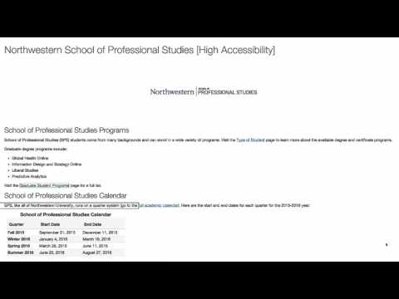
Let’s check out
a page with high accessibility.
Notes:
CS

Slide 12
Policy and advocacy
Get that syllabus statement out there.
Make sure your students are aware of the services they can receive.
Use or modify AccessibleNU’s recommended syllabus statement.
Advocate with your words.
Explain why you’re taking these steps or making these changes to raise awareness about the need for web accessibility.
Notes:
CS: Policy – Syllabus statement connecting students to resources and providing action items for accommodations. (Link to AccessibleNU)
KW: Advocacy – Contextualize. Writing is an opportunity to explain what you’re doing. If you think that students will push back at you for an accessibility technique you’re using, use your words to stand behind web accessibility.

Slide 13
Questions?

Slide 14
Web Accessibility Resources
SPS Distance Learning Technical Editing Site
SPS Distance Learning blog posts on accessibility
AccessibleNU
Northwestern Web Communications Web Style Guide Accessibility Information
Fangs Screen Reader Emulator for Firefox
Notes:
KW & CS
These slides will be available on the DL website soon as an accessible PDF!

Slide 15
Thank you for joining us!
Please contact Christine Scherer or Kristina Wilson
with any additional questions
Notes:
KW & CS

